Slide 1
Testing on all browsers
David Catuhe | Principal Program Manager
Etienne Margraff | Technical Evangelist

Slide 2
Course Topics
How to debug a website using IE F12 tools
01 | Working with web standards | 02 | Debugging with the console and the debugger windows
03 | Optimizing your page | 04 | Developing a mobile web site
05 | Testing on all browsers

Slide 3
05 | Testing on all browsers
David Catuhe | Principal Program Manager
Etienne Margraff | Technical Evangelist

Slide 4
Module Overview
Testing all versions of IE
Testing on all browsers

Slide 5
Testing your website
Why ?
You want to develop for the web (not a specific browser)
You want to get to every person on the planet
You want to give the best experience possible
Some people does not have the latest version of browsers ☺
How ?
Having multiple machines with all versions of all browsers (not recommended)
Using tools and helpers

Slide 6
Testing on all browsers Testing all versions of IE

Slide 7
Where finding tools ?
Your best friend to test on every IE versions
https://www.modern.ie
3 kinds of tools
Downloadable virtual machines (IE6 to IE11)
RemoteApp using Azure (remote version of IE)
Site scanner to get tips to get your website “Web” compatible

Slide 8
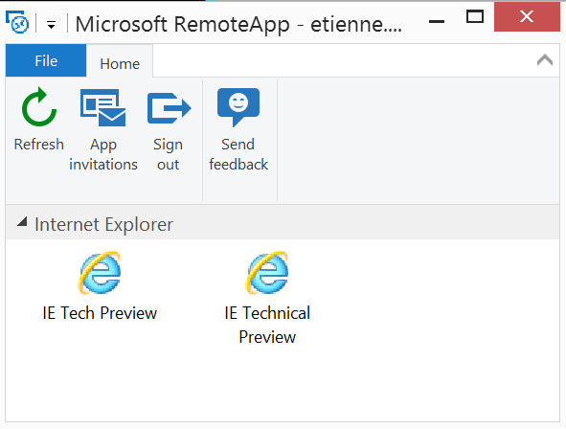
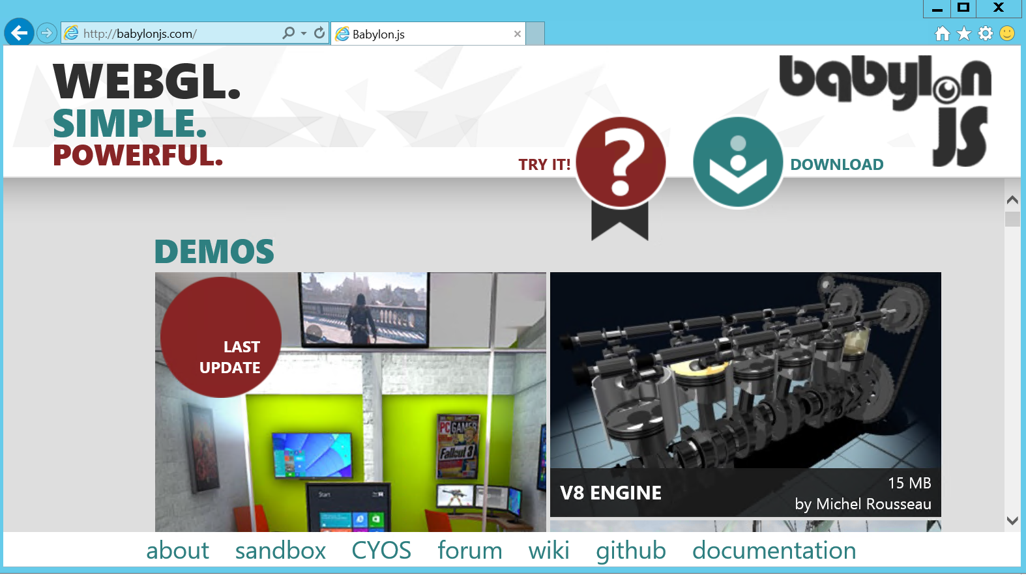
RemoteApp IE
Using Azure
Compatibility
Windows
Mac
iOS
Android

Slide 9
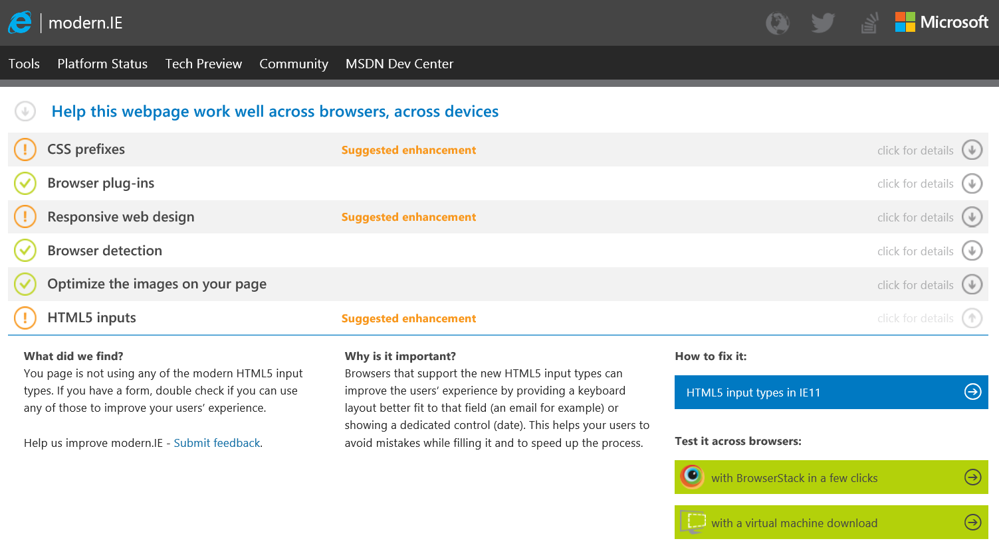
Site scanner
Scan your site
Gives you insights about
CSS rules
Browser detection
HTML5
Etc.

Slide 10
Using moden.ie Demo

Slide 11
Testing on all browsers Testing on all browsers

Slide 12
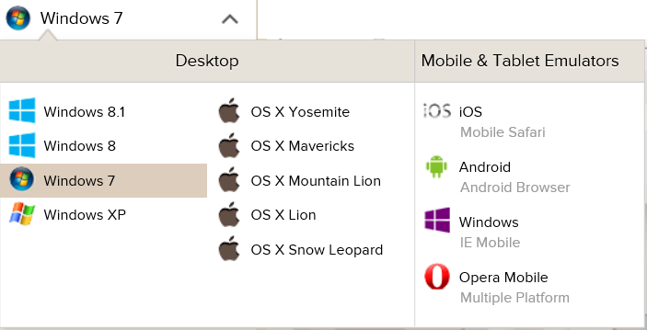
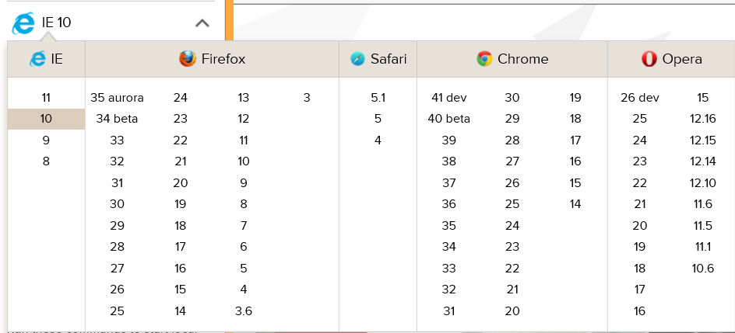
BrowserStack
http://www.browserstack.com
Use real browsers / OS
Web experience
Free trial
Operating systems
Windows XP, 7, 8, 8.1
OSX Snow Leopard, Lion, Mountain Lion, Mavericks, Yosemite
iOS, Windows (phone, tablet), Android, Opera Mobile

Slide 13
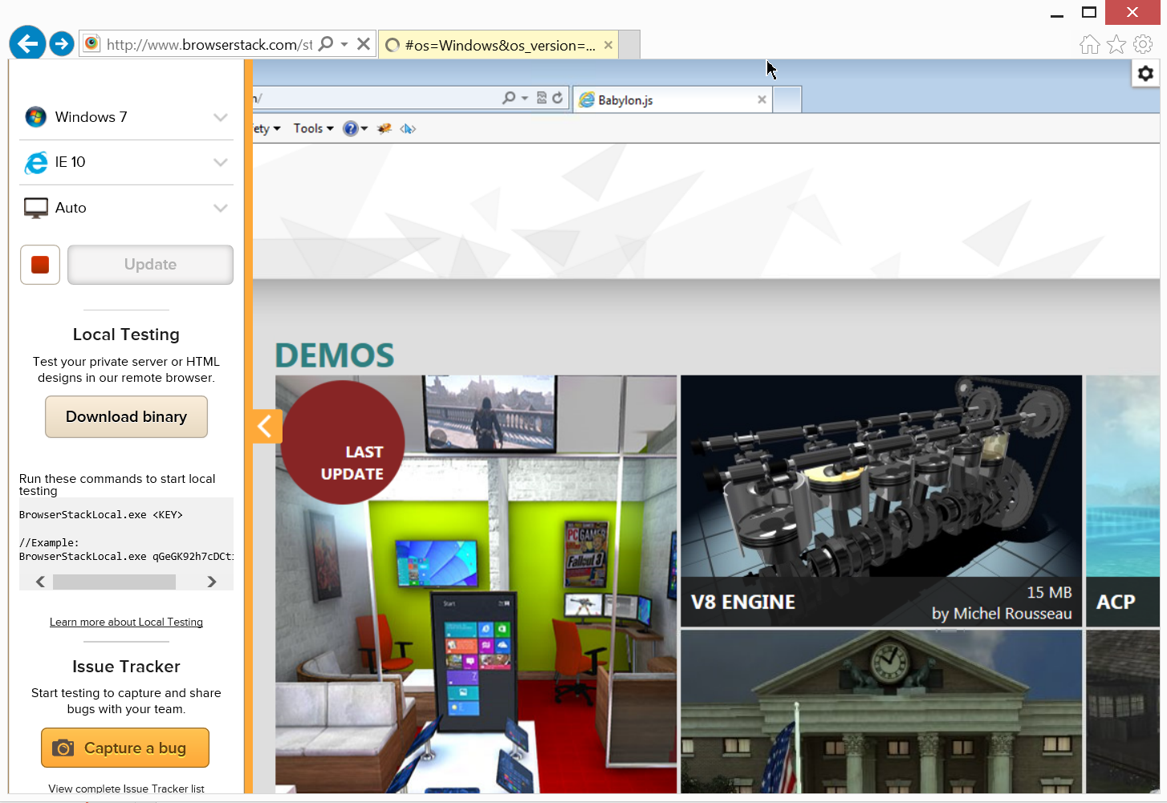
BrowserStack

Slide 14
Testing on all browsers Demo

